Slide 1

Pentris bots
Group 25
Notes:
Introduce group
ALI

Slide 2
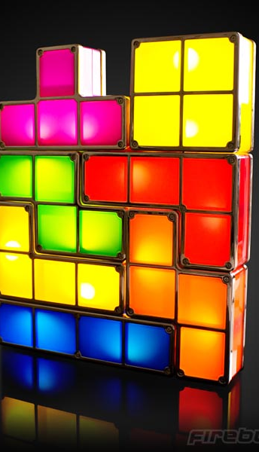
Game
Objective
Scoring
This Photo by Unknown Author is licensed under CC BY-SA-NC
Notes:
Objective: get the highest score by clearing as many rows as possible and trying to clear as many rows at once as possible
Scoring: each cleared row gives 100 points, but when you clear multiple rows at once you get +100*rowNumber
ALI

Slide 3
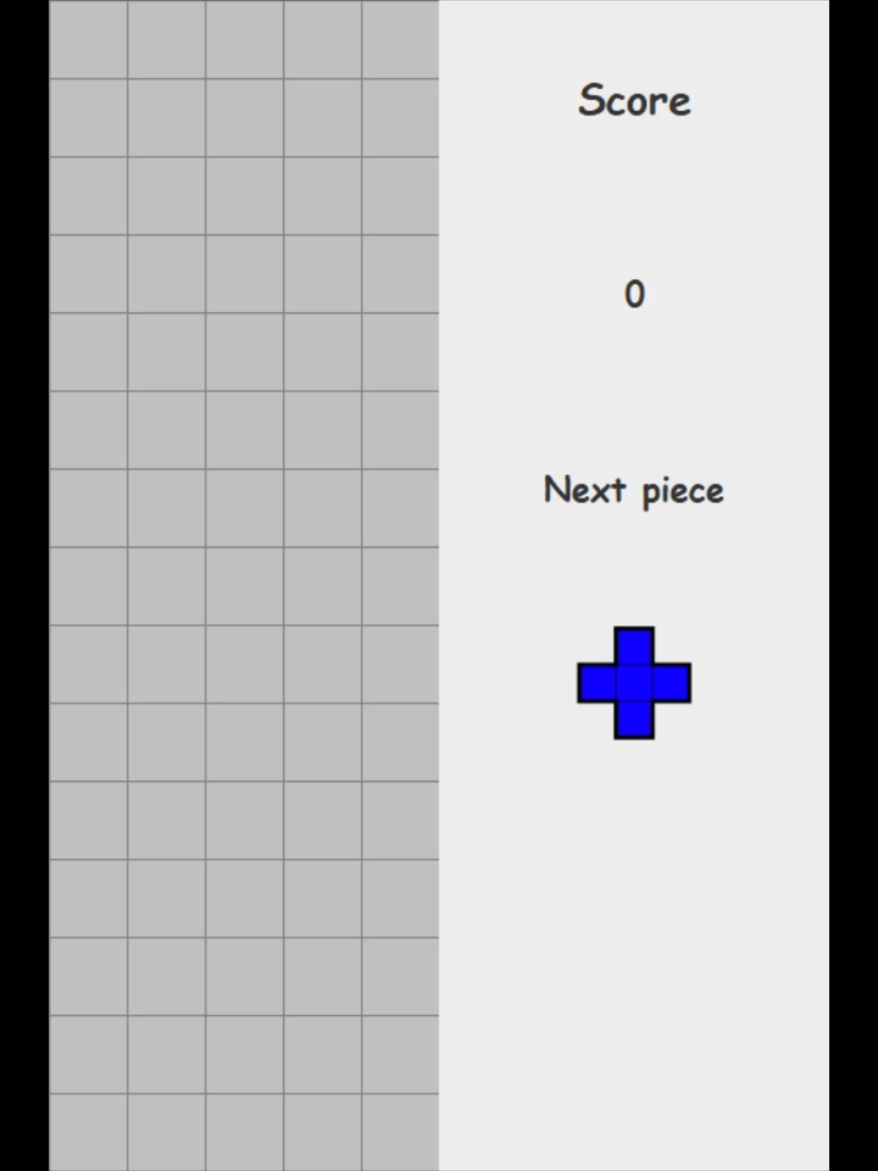
Optimal order
Approach
Algorithm X as a start
Play the game with the given orders
Results
Y T V L N I W Z F X U P
Notes:
Use algorithm X to find ways to fill the desired space completely
Try to use the pieces in an order to fill in that desired space
We didn’t use the ‘score’ multiplier
DRAGO

Slide 4

Bots
Q-bot
G-bot
This Photo by Unknown Author is licensed under CC BY-SA
Notes:
We split the group up into two sub-groups each working on their bot. This was done so that we could try a simpler and more complex approach and everyone could still work on something and learn.
DRAGO

Slide 5
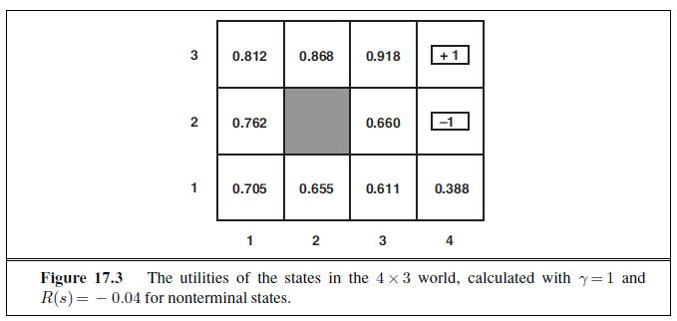
Q-bot
This Photo by Unknown Author is licensed under CC BY-SA
amountOfBlocksSurrounding * (5 * (i + 1)) + 25 * (i) + amountOfBlocksInRow * (3 * (i) + 3) + 1;
Notes:
The Q-bot works by giving every cell in the board a value that represents how useful it would be to fill that cell. It than tries to place a block in such a way that it gives the highest sum of these values.
Explain the scoring system
We didn’t fully finish it since we switched our focus over to the other bot, but we were close to completing it
RENÉ

Slide 6
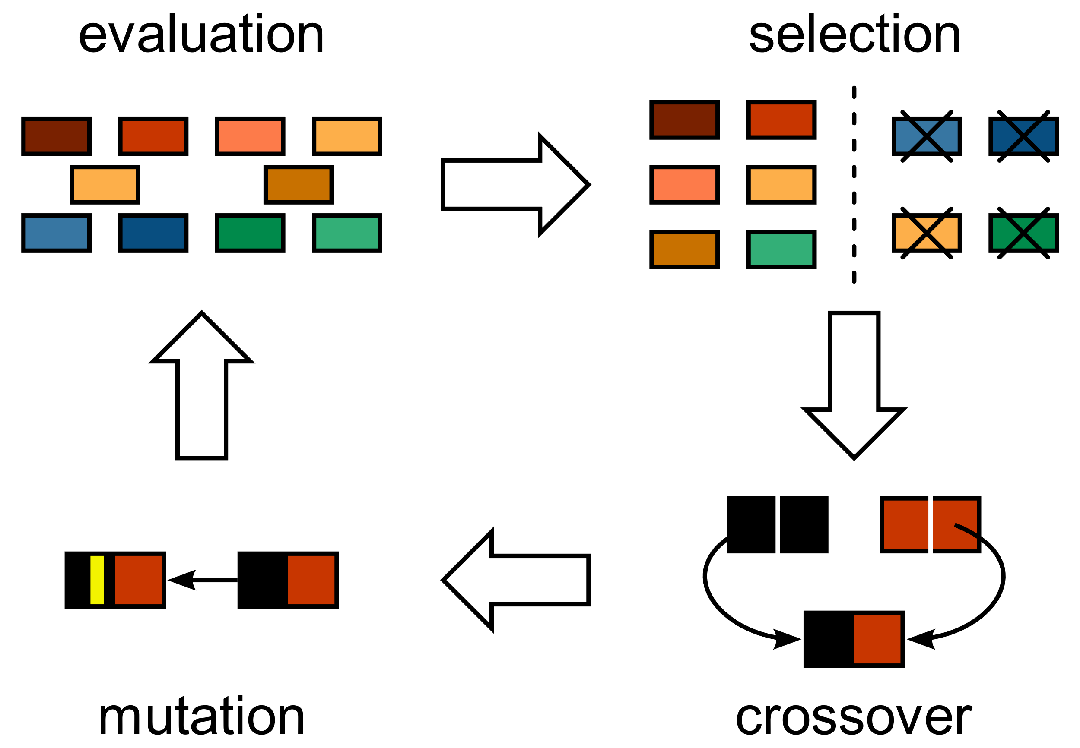
G-bot
This Photo by Unknown Author is licensed under CC BY-SA
Notes:
Explain the basic way it learns
LINDALEE

Slide 7
G-bot process
*Score stands for the best
individual’s average score
Genetic Neural Network
Genetic Algorithm
source:
TetNet, Idrees Hassan
Wider Field?
First Implementation
*score ~2000 over 10 games
Next Piece?
Additional Parameter
Old best move weight
Score ~5000 over 10 games
Testing
100 games average
Local minima?
Inconsistent performance
Risky strategies
Mutation changes
Tournament selection
Population size increase
Optimization
Training speed and games number
Score ~3000 over 30 games
Success!
Score ~5000 over 30 games
Experiment
Notes:
LINDALEE

Slide 8
Difference in field width: score
Notes:
SAMUELE

Slide 9
Difference in field width: holes
Notes:
SAMUELE

Slide 10
Difference in field width: roughness
Notes:
SAMUELE

Slide 11
Difference in field width: move influence
Notes:
SAMUELE

Slide 12
Difference in field width: rows cleared
Notes:
SAMUELE

Slide 13
Bot comparison
 | Q-bot | G-bot
Score | High | 4500
Rows cleared | High | 15
Time to train | None | High
Required processing power during play | High | Very low
‘Cleverness’ | Medium | Medium
Notes:
MAX

Slide 14

What we learned
Communication
Division of work
This Photo by Unknown Author is licensed under CC BY
Notes:
ANDREW

Slide 15

Planning phase 3
Visualization: week 1 and 2
Research: week 1
Implementation: end of week 1, start of week 2 and polish in week 3
Report: introduction, format, etc week 1, finish in week 3
Presentation: week 3
This Photo by Unknown Author is licensed under CC BY-SA
Notes:
ANDREW

